Slide 1
Image Steganography using Pixel Value Difference
MAJOR PROJECT PRESENTATION
SEMESTER IV (2019-2020)
SUBMITTED TO
Prof. Sunil Kumar Muttoo
SUBMITTED BY
Kulpreet Kour(1893904)
Moni Tripathi(1893908)

Slide 2
ABSTRACT
A new data hiding method is proposed in this project ,which can increase the steganographic security of a data hiding scheme. We have done project on pixel value difference.In the process of embedding a secret message,a cover image is partitioned into non-overlapping blocks of two consecutive pixels. A difference value is calculated from the values of the two pixels in each block. All possible difference values are classified into number of ranges. As human eye has limited tolerance when it comes to texture and edge areas than in smooth areas , and as the difference between the pixel pairs in those areas are larger. The difference value is then replaced by a new value to embed the value of a substream of the secret message.

Slide 3
What is Steganography?
Steganography is the art and science of writing hidden messages in such a way that no one, apart from the sender and intended recipient, suspects the existence of the message.

Slide 4
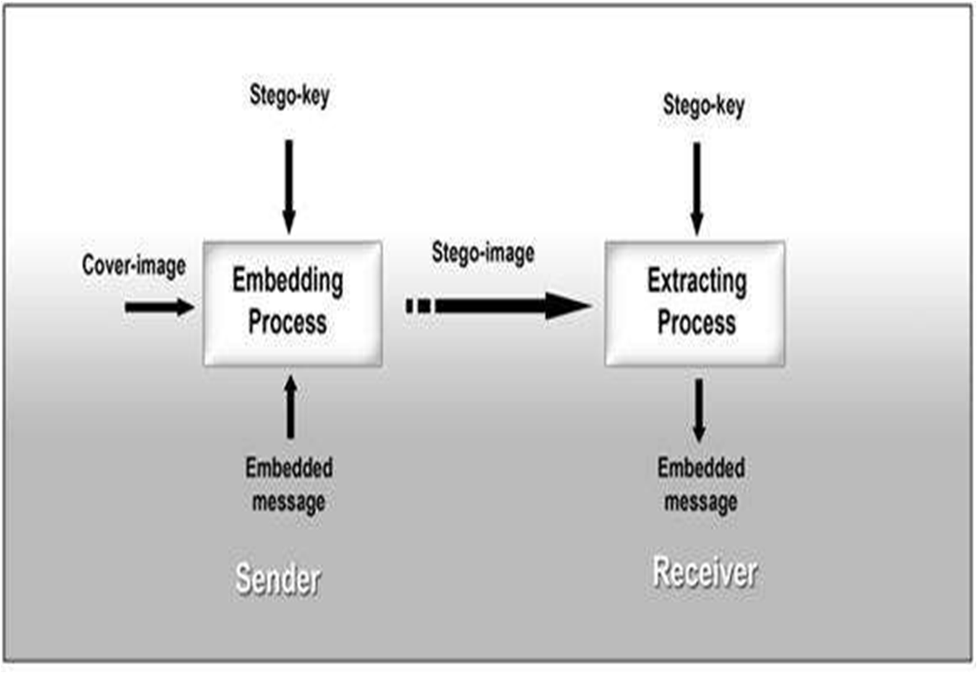

Slide 5
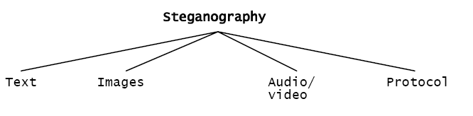
Categories of Steganography

Slide 6
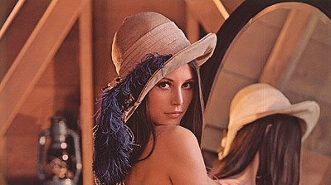
What is Image Steganography?
Image Steganography is the technique of hiding the data within the image in such a way that prevents the unintended user from the detection of the hidden messages or data
ORIGINAL IMAGE STEGO IMAGE

Slide 7
Pixel Value Differencing
The Pixel-Value Differencing (PVD) scheme uses the difference value between two consecutive pixels in a block to determine how many secret bits should be embedded.
pixel value differencing is able to provide a high quality stego image in spite of the high capacity of the concealed information.
That is, the number of insertion bits is dependent on whether the pixel is an edge area or smooth area.
In edge area the difference between the adjacent pixels is more, whereas in smooth area it is less.

Slide 8
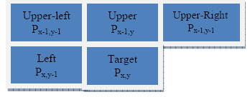
This method hides the data in the target pixel by finding the characteristics of four pixels
Surrounding it, indicated in the table below:

Slide 9
Embedding Algorithm
Step 1.We simply divide the cover image into a number a non overlapping two pixel blocks.
Step 2.Each block is categorized according to difference of the gray values of the two pixels in the block.
Step 3.A small difference value indicates that the block is in smooth area a larger one indicates that it is in edged area.

Slide 10
Step 4.The pixels in edged areas may, as mentioned previously , tolerate larger changes of pixel values than those in the smooth areas.
Step 5. Read secret bits from the secret bit stream, and transform it into decimal value .
Repeat Steps 1–5 until all secret bits are embedded and the stego image is produced.

Slide 11
Step 6. Classify pixels based on the difference in pixel value to the number of bits to be substituted to LSB.
Step 7. Calculate embedding capacity of the given cover image using pixel value difference.
Step 8. Calculate the embedded bits in the stego image.
Step 8.1 If the number of bits required is less than the number of bits in the data(char.) to be Embedded.
Step 8.2 If the number of bits required is more than the number of bits in the data(char.) to be Embedded

Slide 12
Extraction Algorithm
Step 1. Check if a new character in embed log is reached.
Step 2. Check if embedded pixel is red.
Step 3. Check if embedded pixel is green.
Step 4. Check if embedded pixel is blue.
Step 5. For checking if character has changed in embed file.

Slide 13
EXECUTION
FIRST IMAGE

Slide 14
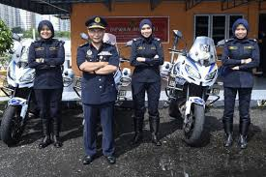
WE HAVE TAKEN SECOND IMAGE
ORIGINAL IMAGE STEGO IMAGE

Slide 15

WE HAVE TAKEN THIRD IMAGE
ORIGINAL IMAGE STEGO IMAGE

Slide 16
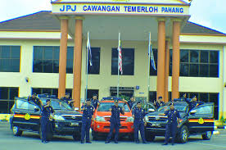
WE HAVE TAKEN FOURTH IMAGE
ORIGINAL IMAGE STEGO IMAGE

Slide 17

PEAK SIGNAL TO THE NOISE RATIO
PSNR is defined as follows:
PSNR=10Log10(L-1)^2/MSE=20Log10(L-1)/RMSE
Here, L is the number of maximum possible intensity levels (minimum intensity level suppose to be 0) in an image.
MSE is the mean squared error & it is defined as:
MSE=1/mn
Where, O represents the matrix data of original image. D represents the matrix data of degraded image.
m represents the numbers of rows of pixels and i represents the index of that row of the image.
n represents the number of columns of pixels and j represents the index of that column of the image.
RMSE is the root mean squared error.

Slide 18
RESLUTS
No. Of Characters in txt PSNR
1,218 58.8268
3,654 54.2545
7,308 51.5452
12,180 49.3938
18,270 46.3541
24,360 44.0011
30,450 42.8355
36540 41.9411
42630 41.3420
48720 40.9492
54810 40.6257
60900 40.6257
66990 40.6257

Slide 19
FILTERS ON THE IMAGE

Slide 20
RESLUTS
no. of characters in the txt file psnr value
1,218 60.316
3,654 55.876
7,308 53.258
12,180 51.5680
18,270 49.42248
24,360 47.8772

Slide 21
CONTOURING OF THE IMAGE

Slide 22
RESULTS
no. of characters in the txt file psnr value
1,218 54.868
3,654 51.226
7,308 48.932
12,180 47.2463
18,270 45.1648
24,360 43.5397

Slide 23
EDGEENHANCE OF THE IMAGE

Slide 24
RESULTS
no. of characters in the txt file psnr value
1,218 56.584
3,654 51.027
7,308 48.436
12,180 46.7578
18,270 44.4098
24,360 42.8495

Slide 25
EMBOSS OF THE IMAGE

Slide 26
RESULTS
no. of characters in the txt file psnr value
1,218 57.607
3,654 54.440
7,308 52.307
12,180 50.5942
18,270 47.9808
24,360 45.7946

Slide 27
GAUSSIAN OF THE IMAGE

Slide 28
RESULTS
no. of characters in the txt file psnr value
1,218 59.9855
3,654 55.206
7,308 52.765
12,180 51.0688
18,270 48.6405
24,360 47.1403

Slide 29
LAPLACIAN OF THE IMAGE

Slide 30
RESULTS
no. of characters in the txt file psnr value
1,218 58.185
3,654 53.727
7,308 50.822
12,180 48.8420
18,270 46.3883
24,360 44.14066

Slide 31
HISTOGRAM OF THE IMAGE

Slide 32
HISTOGRAM OF IMAGE IN RGB FORM

Slide 33
NEGATIVE OF THE IMAGE

Slide 34
LOG TRANSFORM

Slide 35
GAMMA CORRECTION

Slide 36
CONCLUSIONS
A new and efficient computer based steganographic method for embedding secret messages into images without producing noticeable changes has been proposed. Hiding data in the LSBs of the pixels of the gray valued image is a common information hiding method that utilizes the characteristics of the human vision’s insenstivity to small changes in the image. This simple LSB embedding approach is easy for computation , and a large amount of data can be embedded without great quality loss.
This method not only provides a better way for embedding large amounts of data into cover images with imperception , but also offers an easy way to accomplish secrecy. This embedding method can be easily extended to efficiently carry content related messages such as captions or annotations in audios and videos by embedding data in each adjacent pair of signals of the data streams.

Slide 37
Not all pixels in an image can tolerate equal amounts of changes without causing notice to an observer. Changes of the gray values of pixels in smooth areas in images are more easily noticed by human eyes. So in the proposed method we embed more data in edged areas than in smooth areas. And it is in this way that we keep the changes in the resulting stego image unnoticeable.

Slide 38
REFERENCES
Research paper : A steganography method for images by pixel value differencing.(by Da Chun Wu Wen Hsiang Tsai)
Research Paper : Colour Image Steganography based on pixel value diffrencing in spatial domain.(by J.K.MANDAL AND DEBASHIS DAS)
https://www.geeksforgeeks.org/python-pil-image-filter-with-imagefilter-module/
https://docs.opencv.org/3.4/d5/db5/tutorial_laplace_operator.html

Slide 39
https://www.geeksforgeeks.org/opencv-python-program-analyze-image-using-histogram/
https://www.geeksforgeeks.org/python-intensity-transformation-operations-on-images/
https://www.geeksforgeeks.org/python-peak-signal-to-noise-ratio-psnr/

